Slide 1
Advanced Calculator Using Python
Priya Verma
Internship – Nexthikes IT Solution

Slide 2
Introduction – This Project is a GUI based calculator built using Python Tkinter to perform mathematical Operation
Tool Used
1.Python
2.Visual Studio Code
3. GitHub

Slide 3
Feature of Python Calculator
Basic arithmetic operations
Decimal and percentage
Backspace and clear
Calculator History
Error Handling

Slide 4
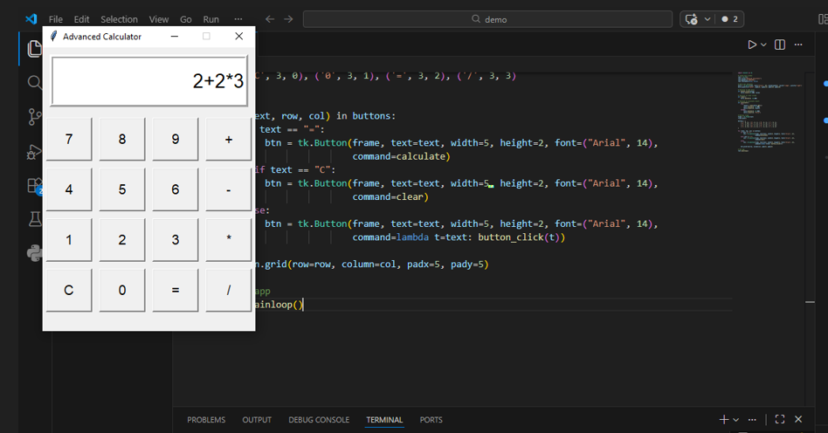

Slide 5
Calculator Logic Code
Tkinter creates GUI
Python handles logic
History is stored in list
Learning Outcome
1 . GUI Development
2 . Python Logic Building

